Slide 1
Video Object Segmentation
Video Object Segmentation using Space-Time Memory Networks, ICCV, 2019.
Efficient Regional Memory Network for Video Object Segmentation, CVPR, 2021.

Slide 2
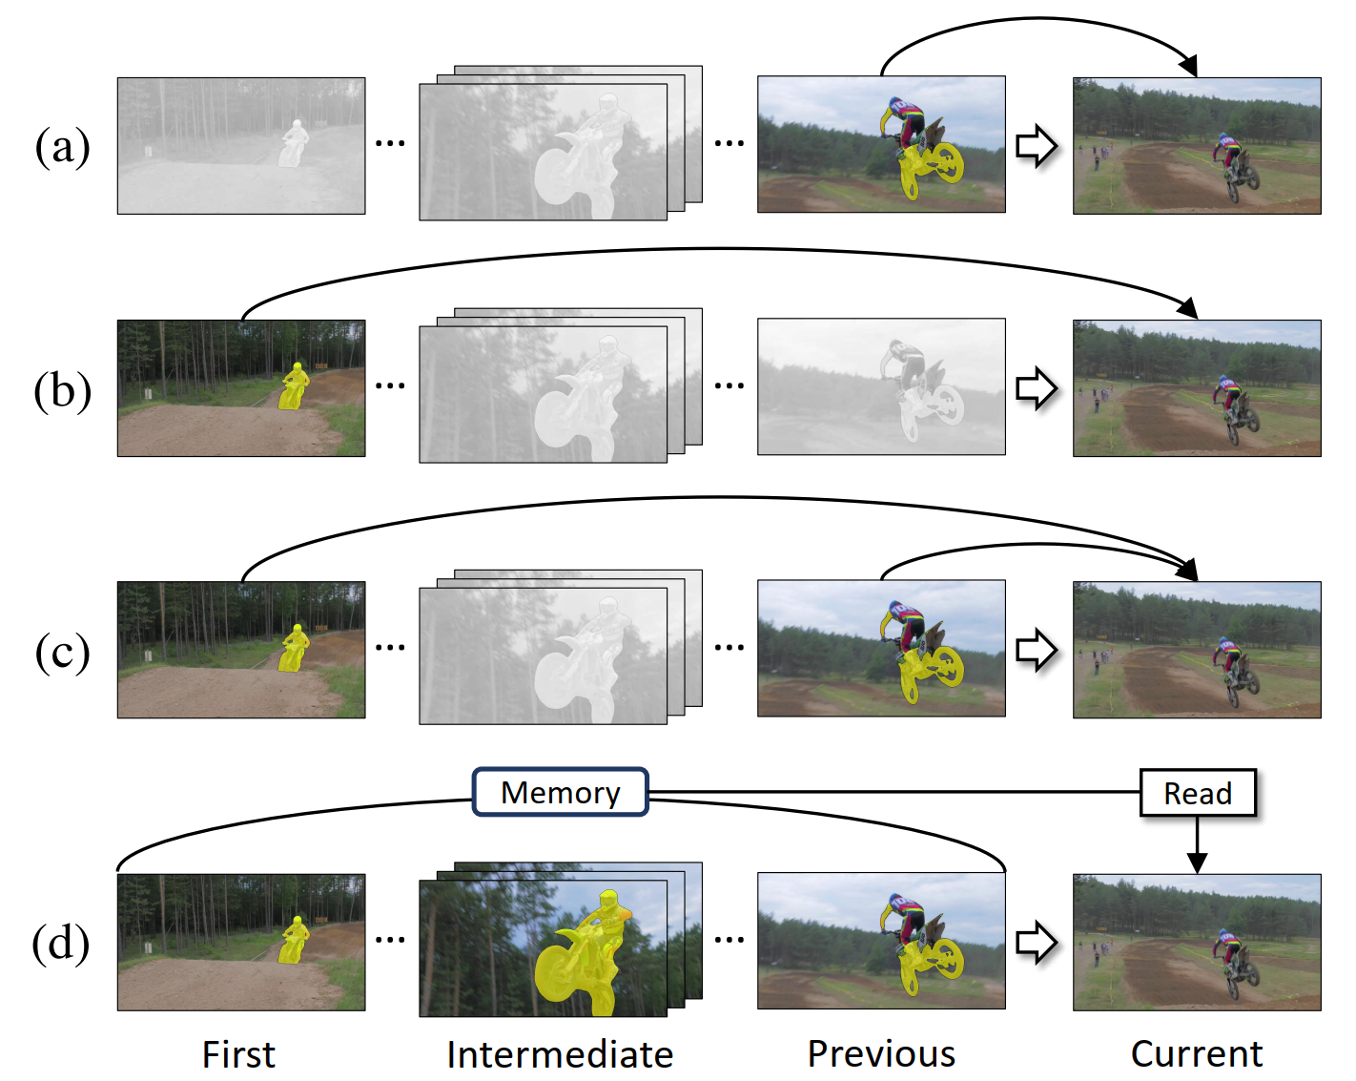
Video Object Segmentation
The ground truth mask of the target object is given in the first frame and the goal is to estimate the object masks in all other frames.

Slide 3

Video Object Segmentation using Space-Time Memory Networks
ICCV 2019

Slide 4
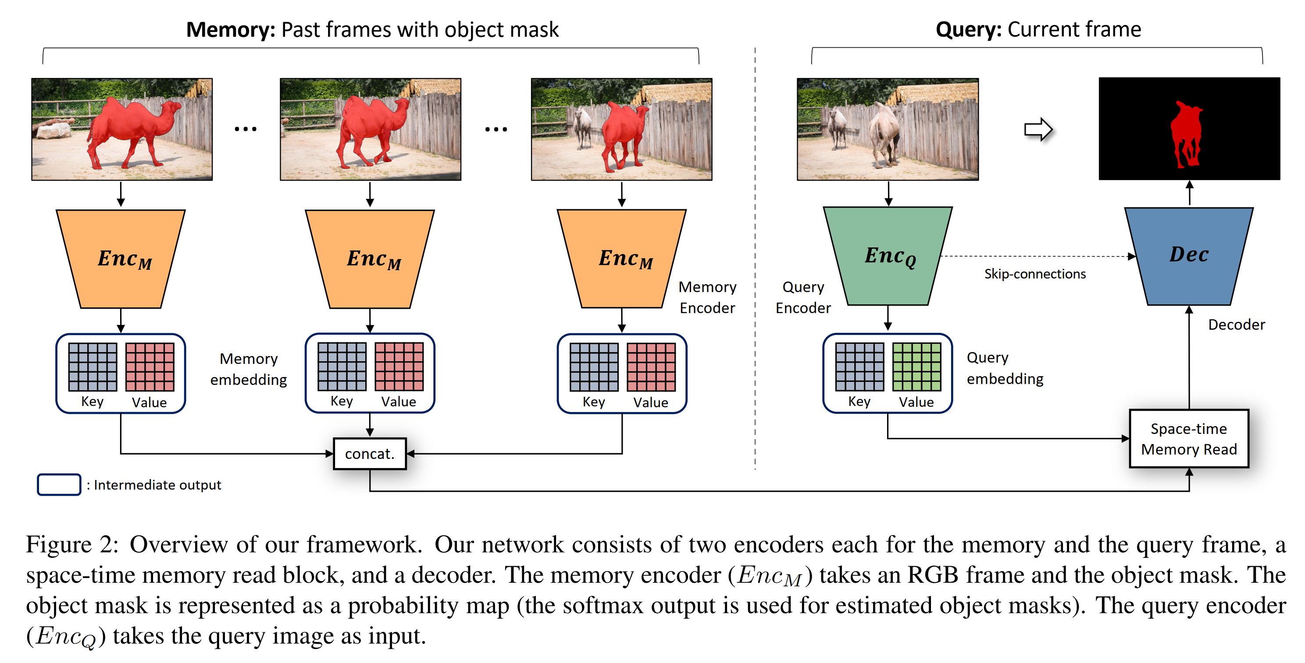

Motivations & Methods
﻿how to design an efficient deep neural network (DNN) architecture that exploits all the frames.

Slide 5
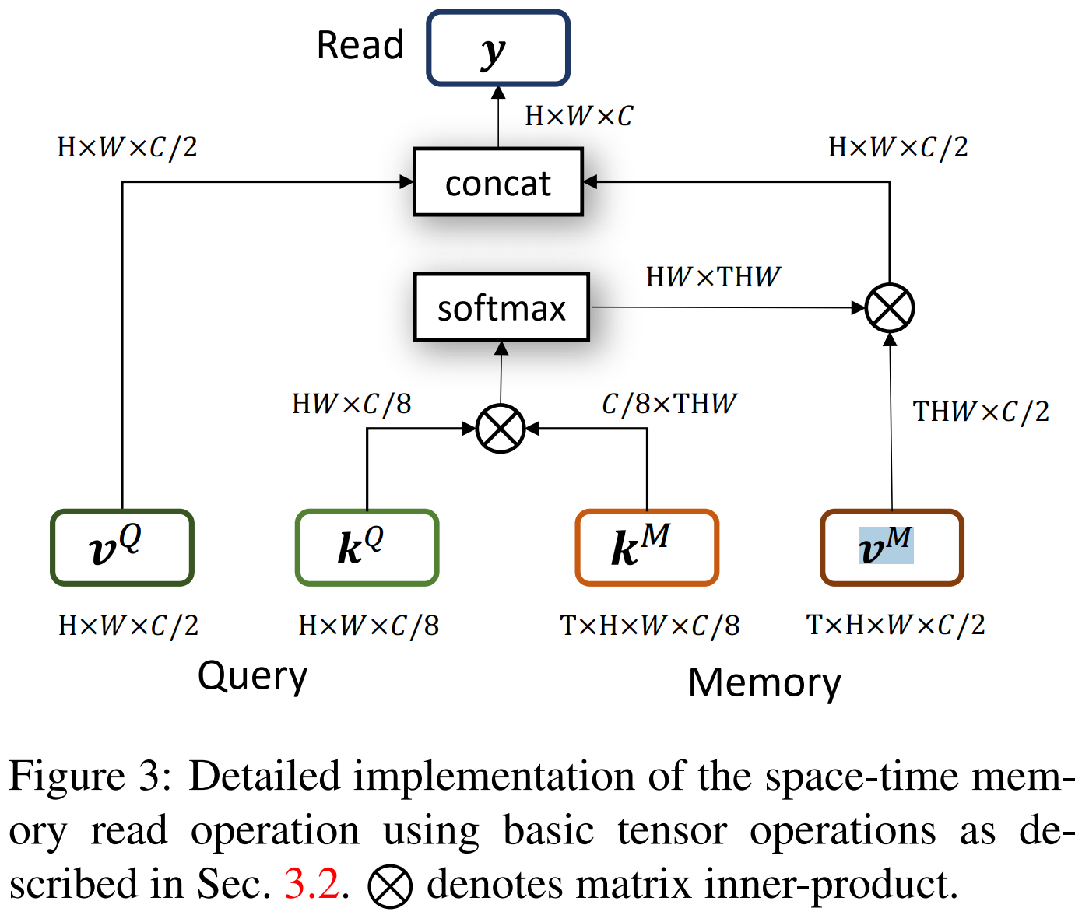
Space-time memory read operation

Slide 6
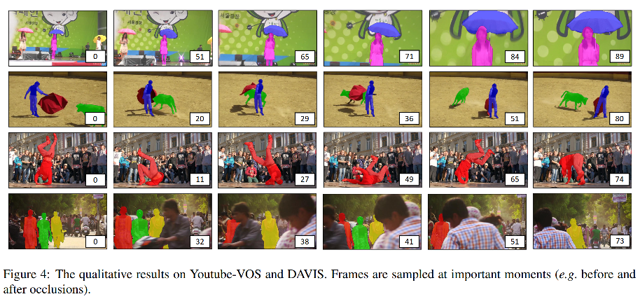

Slide 7
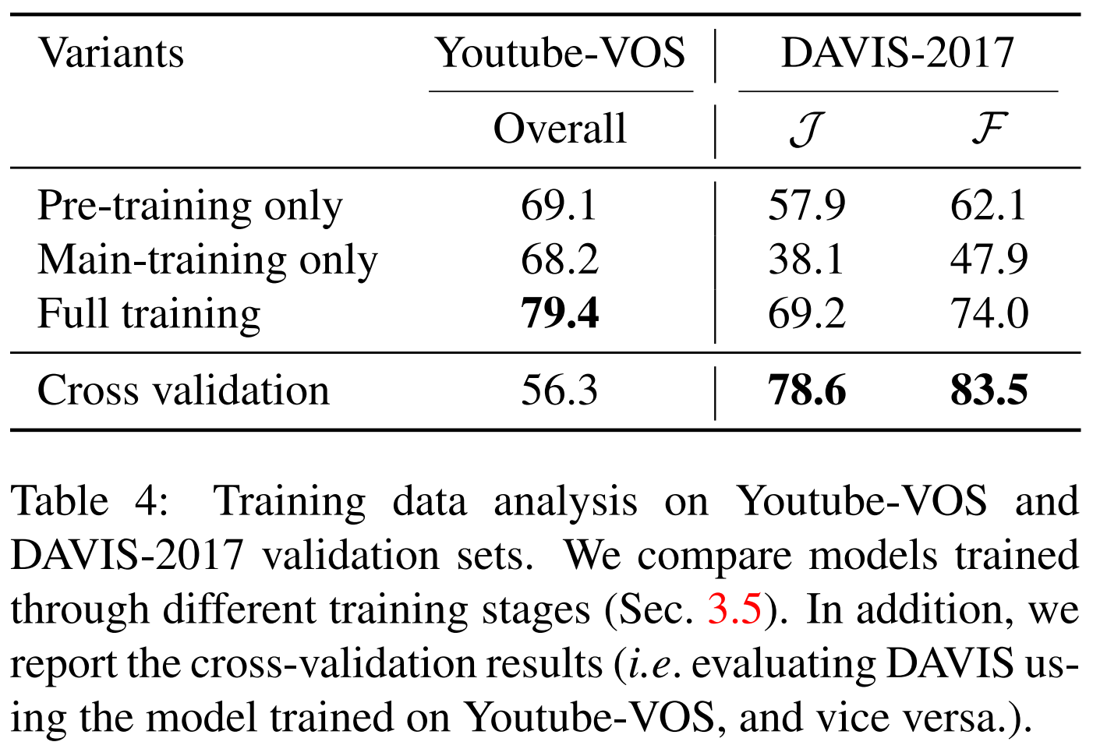
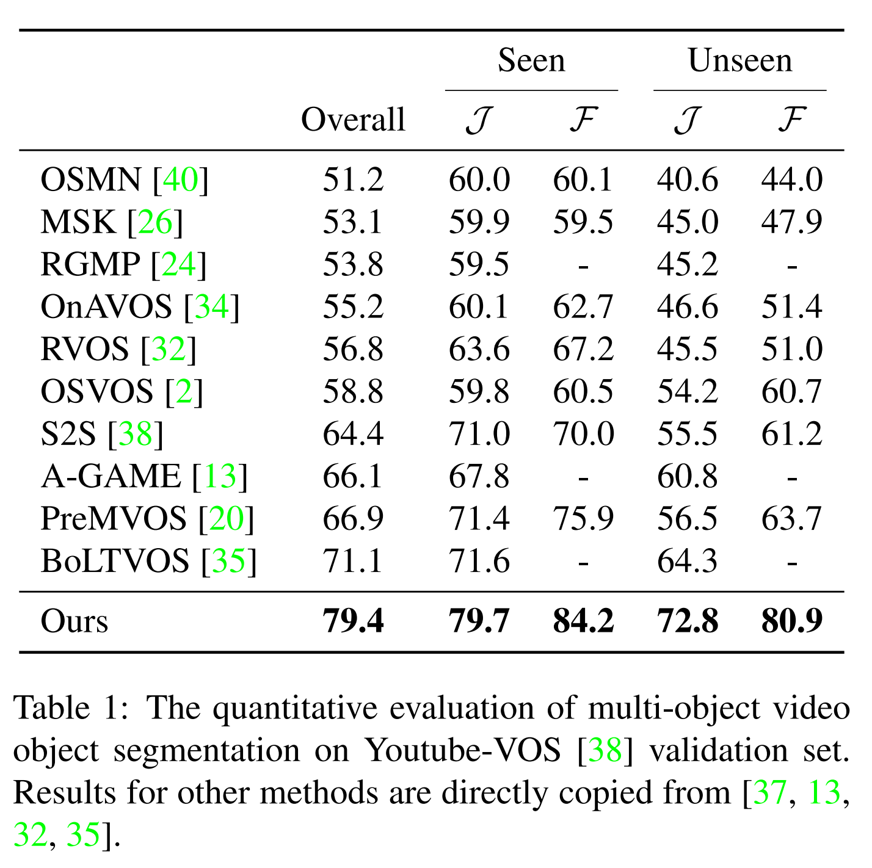
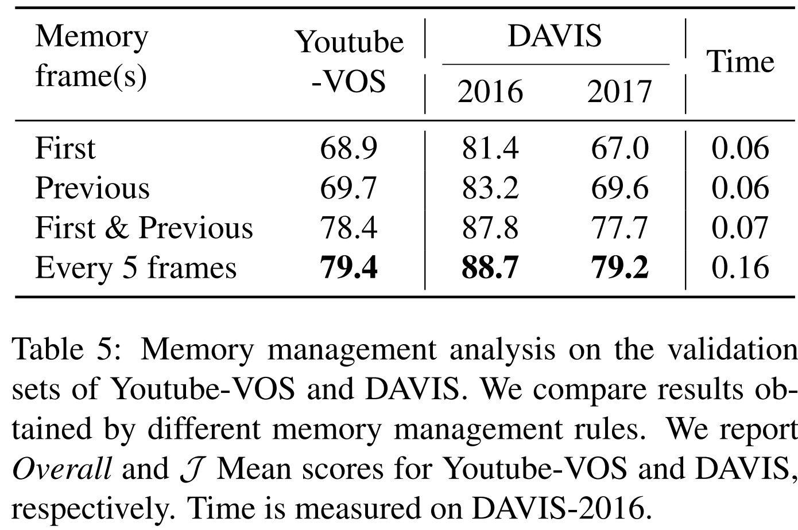

Slide 8

﻿Efficient Regional Memory Network for Video Object Segmentation
CVPR 2021

Slide 9
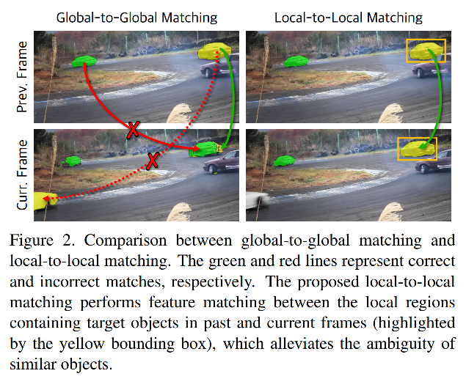
Motivation
High computational Complexity.
Mis-match for similar objects in the global-to-global matching.

Slide 10
Core Idea
According two adjacent frames, we can estimate the optical flow, and then wrap the previous object masks to the current frame.
We present the Regional Memory Reader, which performs feature matching between the regions containing target objects. It is time efficient and effectively alleviates the ambiguity of similar objects.

Slide 11
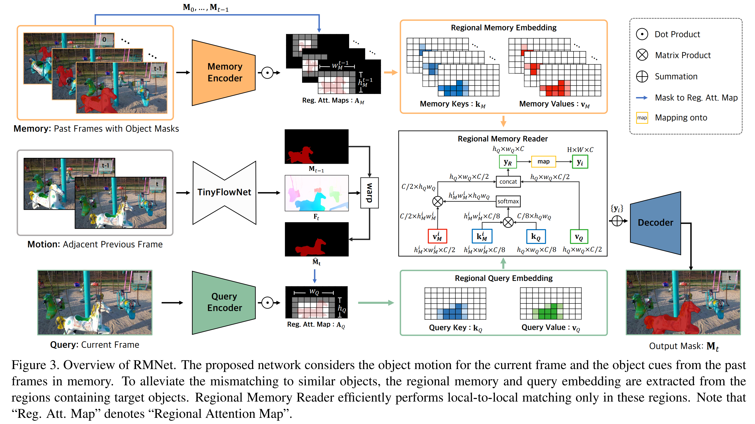

Slide 12
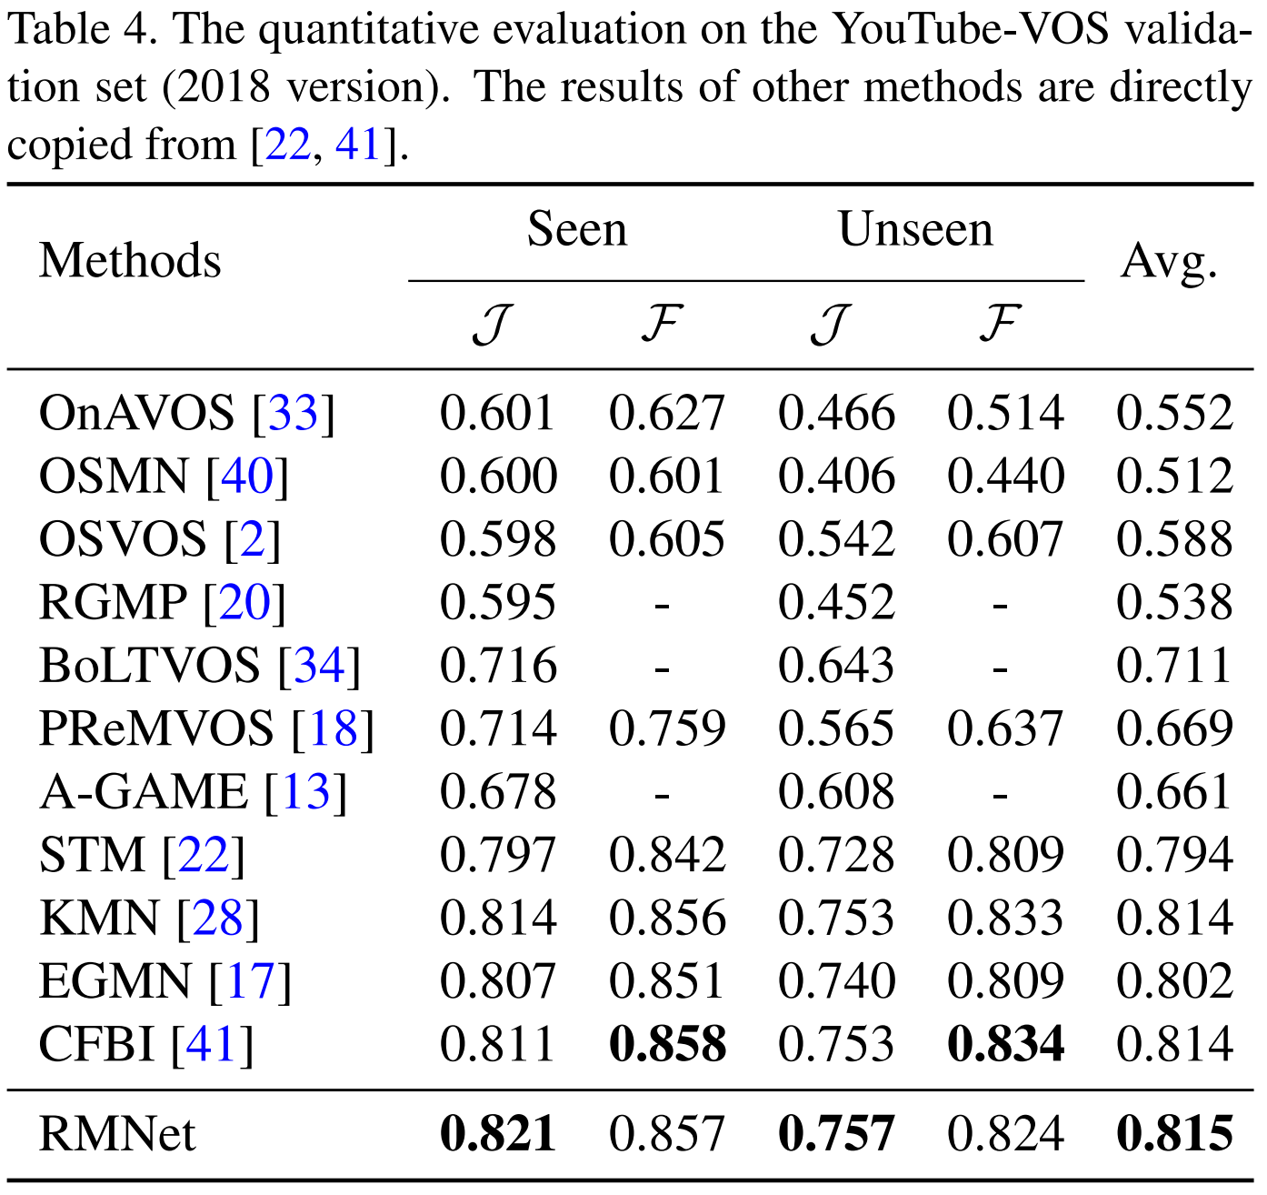
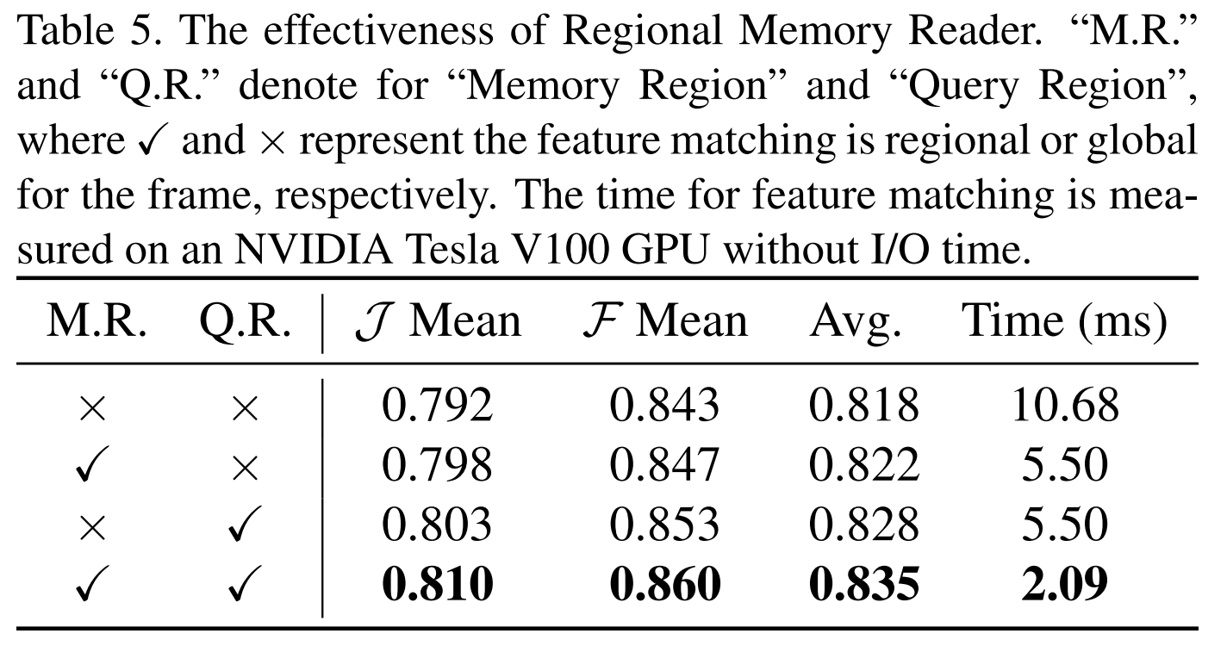

Slide 13
Thanks !

